Slide 1
CELCIS Education Forum
Thursday 18th March 2021
www.celcis.org
@CELCISTweets

Slide 2
Next to their families, schools have the strongest influence on children's development and the benefits of a good educational experience can be greatest for those who have experienced adverse childhood experiences in their home life.
Education Matters!
18th March 2021
Welcome
This Photo by Unknown author is licensed under CC BY-SA.

Slide 3
Plan for CELCIS Education forum
Who are our care-experienced learners? Care Leaver , Care-Experienced? Both?
Why does this matter?
Who are the HUB and what do we do?
"The sum is greater than the whole of its parts" - why partnership matters? Sam's story through a conversation with Catherine.

Slide 4
Why does the education of our children matter? Research tells us;
Poor educational performance of children in the care-system is not a new phenomenon
Children in care, experience extraordinary educational disadvantage
Doing well at school is unquestionably a key factor in maximizing children's life chances
Educational attainment is strongly linked to health and economic outcomes, such that, the disadvantage faced by CEYP in receiving a disrupted education can profoundly shape their adults lives. (SFC 2020)
Many young people come into care with a history of educational difficulties.
Their pre-care experience will mean they are always playing catch up with their peers
The Promise
Notes:
Indeed. There is evidence from as early as the 1960's has indicated that being in care carries a high risk of educational failure. (ES Esson, Lambert and Heat 1976 Ferguson, 1966 Stein and Carey 1986
Historical differences usually stem from experience of social exclusion and multiple disadvantage
Education was definitely a key factor in my life, in comparison to my peers?
NOT A NEW PHENOMENAN – Over the last 20 years its become more widely recognised, before that the low attainment levels of our group was simply overlooked or taken for granted. Educational attainment is strongly linked to health and economic outcomes, such that, the disadvantage faced by care-experienced young people in receiving a disrupted education can profoundly shape their adult lives.

Slide 5
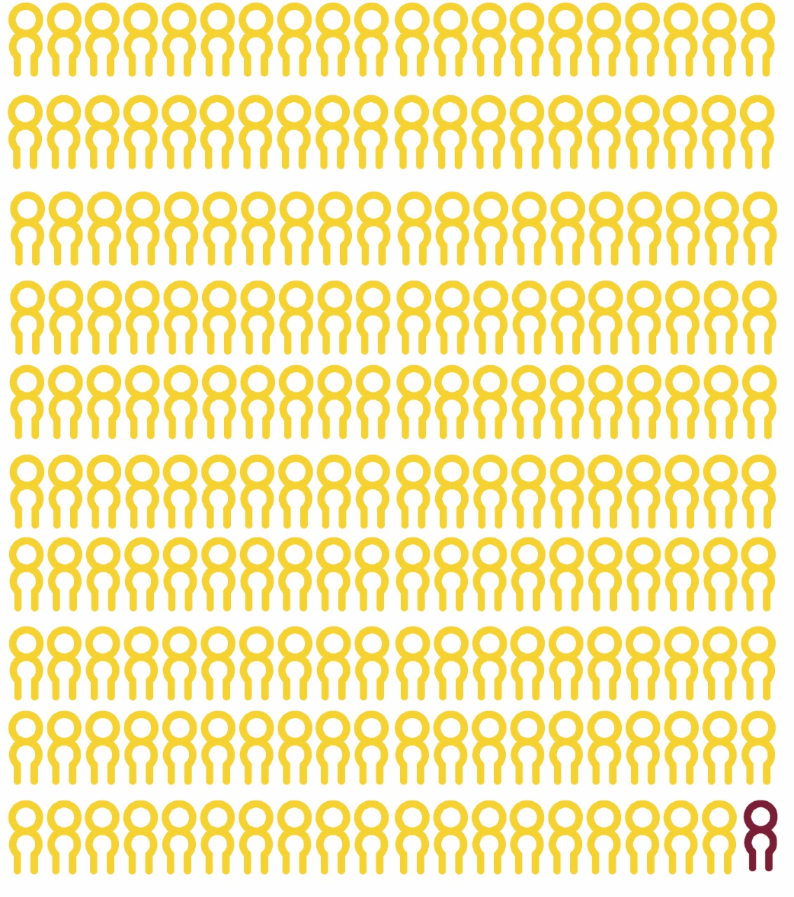
Looked after Children and Young People
Approx. 14,015 children and young people in care (those formally Looked After by the Local Authority)
That’s 2% of all Scotland’s children and young people.
(Scottish Government 2020)
Notes:
The point is that this is a small population so we should and could be doing better. WE can and must do better
The little red character is who we are talking about today

Slide 6
Why do children and young people come into care?
‘Lack of parental care’ was the most common ground (reason) for referral.
In 2019/2020, 12,849 children and young people were referred to SCRA. (childrens hearing panel)
10,823 on non-offence (care and protection) grounds
2,840 on offence grounds
T
Notes:
So who are these children whom we are corporate parents too and why do they end up in care?

Slide 7
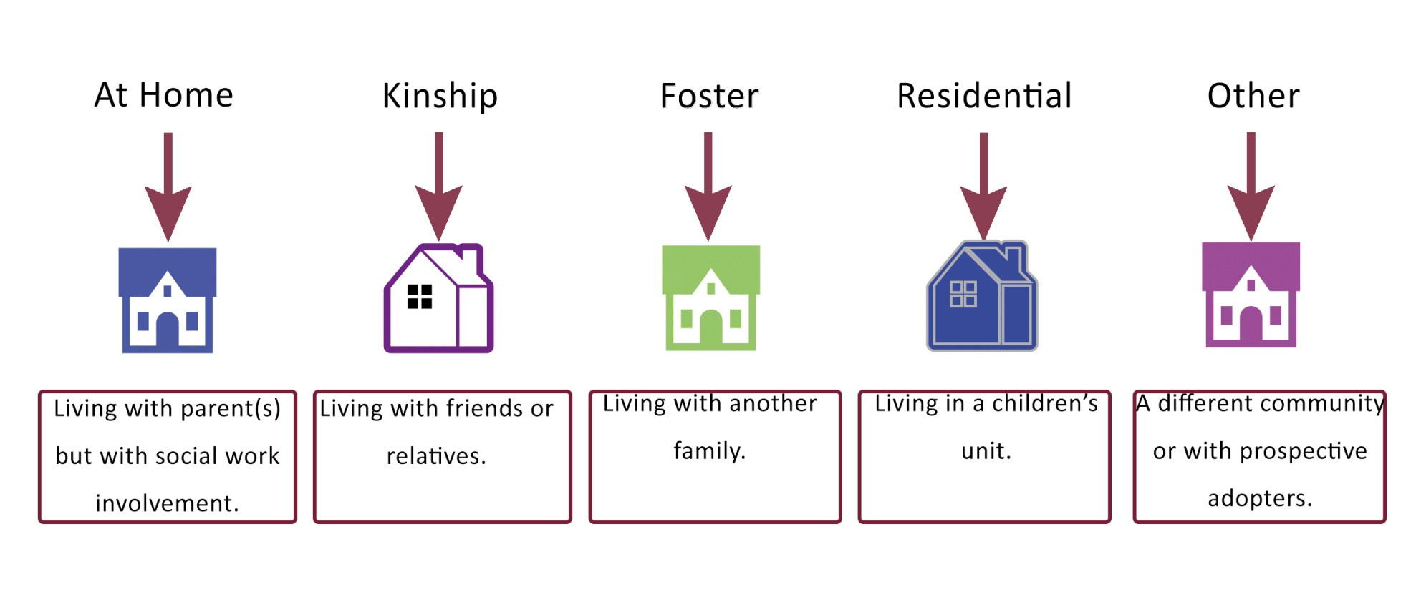
We do we live while in care?
25%
28%
35%
10%
2%
Scottish Government, 2020
Notes:
It is important to be clear about what It means to be care experienced

Slide 8
Who are we?
Edinburgh Napier University
University of Edinburgh
Heriot Watt University
Queen Margaret University
The OU Scotland
Edinburgh College
Newbattle Abbey College
City of Edinburgh Council
Introduction of Corporate Parenting, in the 2014 CYPC (Scotland) Act.
Notes:
Comparison;
- 3x no immediate info, 2x generic email/number, 3x Named Person, but one with generic number
Left 3 messages, no response
Conflict with Info on Propel.org
Challenges; economic competition and reputation competition - size of institutions - ‘Enforced Targets’
Challenge is to get them to work together
How to engage unwilling participants; Bridges, Kotter model of change

Slide 9
We are a "hybrid" organisation
Work to ensure that support for care - experienced people is appropriate available and accessible
Create connections between the Hub for SUCCESS, local authority services and third sector bodies
Challenge educational inequalities
Work in partnership to support learners
Lead and develop the HUB partnership and activities
Work together to Keep The Promise
Individual advice about choosing the right course/pathway open to any age group including those over 26
Advice and information about financial support
One to one meetings – drop out as well as drop in
Links into all the partner colleges and universities
Links directly with the Through Care After Care Team
Coaching approach

Slide 10
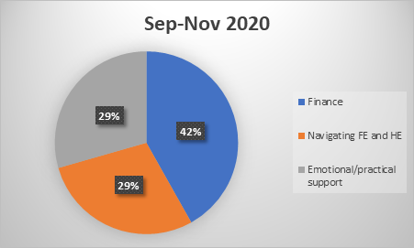
Summary of issues (1 Sep – 30 Nov 2020)
Supported 51 learners with 129 referrals
You can broadly split issues faced by learners into 3 groups:
42% of issues were finance related (eg bursary, application, low income, accessing benefits/grants) (BLUE)
29% were related to navigating further and higher education systems (eg course options/applications, linking into pastoral and additional support, changing course) (ORANGE)
29% of issues were about providing practical and emotional support (eg feeling anxious about studies, mental health issues, struggling with IT issues) (GREY)
26 were new learners and 25 had been in contact with HUB before
Notes:
I wanted to understand more about the types of issues we are supporting learners with and so I looked at the 67 referrals from the last quarter and managed to divide the issues they came to us with into 3 broad groups. These are finance, navigating further and higher education and providing emotional and practical support.
The majority of issues were largely finance related, including filling out bursary application forms, help with childcare costs, housing costs, benefits information
30% navigating the education system
22% were about needing practical and emotional support

Slide 11
Sam's story, a conversation with Catherine.
Taken into care- parental neglect – care-experience spanning over 15 years. Left school with no qualifications
Spent time in secure care and young offenders
Attended duty appointment TCAC – referred to HUB
Supported to apply to college
Coached about potential. Positive and curious
EC positive pastoral support despite challenges
Joint approach to get funding for housing costs. We approached the local authority for support with housing costs – he was refused.
Applied to NBA – prep for further education
Offered a conditional place at Edinburgh University

Slide 12
What happens at school?

Slide 13
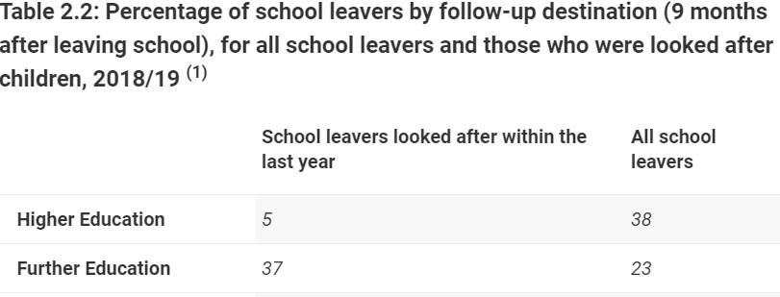

Slide 14
Care-Experienced Students UNIVERSITY

Slide 15
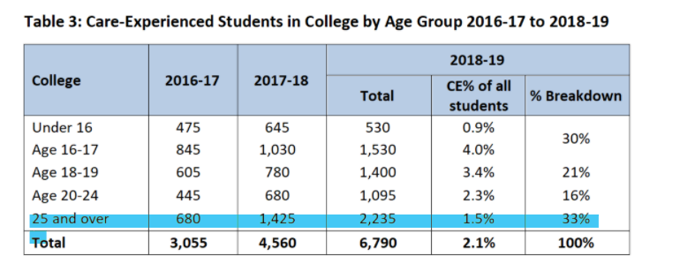

Slide 16
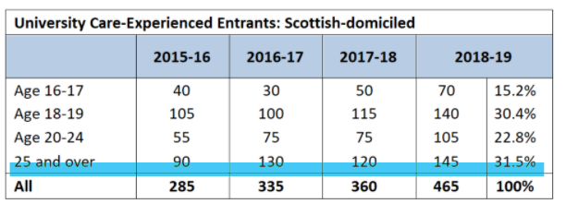

Slide 17
Collaboration and Partnership
Education providers cannot alone improve educational outcomes for looked after children.
Stability by itself is not sufficient—it has to be combined with someone committed to helping the young person and providing a supportive and encouraging environment for study (Mike Stein—Resilience and young people leaving care p13).

